Slide 1




SoftUni
Welcome to Software University
SoftUni Team
Technical Trainers
Software University
http://softuni.bg

Slide 2
Welcome to SoftUni
Software University (SoftUni)
High-quality education, profession and jobs for software engineers
4 professions: 20+ practical courses → ~ 2 years
Bachelor diploma: 2 years @ SoftUni + 1-2 years at partner university (MTM College, VFU, BFU)
Study onsite and online (with onsite exams)
Jobs in Bulgaria and abroad
Free start for everyone
New Programming Basics course each month

Slide 3
Diplomas and Certificates
Course Certificates
Every course, passed with grade >5.00 – granted Certificate
Professional Diploma from SoftUni
JavaScript Developer: >130 credits
PHP Developer: >130 credits
C# Web Developer: >170 credits
Java Web Developer: >170 credits

Slide 4
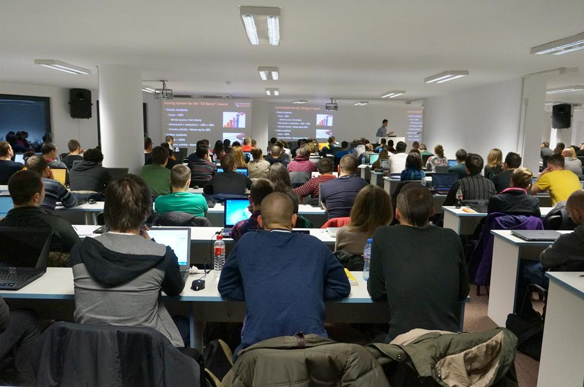
Specialized Courses
Students take credits from specialized (elective) courses
QA Fundamentals
IT Basics
Digital Marketing and SEO
Data Structures
Algorithms
Many others …
The elective courses are open for everyone

Slide 5
Jobs
SoftUni helps the students to start a job in the IT industry
Contracts with 60+ companies for hiring students
Best students study free with scholarship
Students with high results choose between many employers
Students with bad results are not guaranteed to start a job
Internships in Germany and USA

Slide 6

Curriculum and Schedule

Slide 7
SoftUni: Curriculum, Modules, Timeline
Free Entry
Module
9
Programming Basics
4 months
Coding for beginners
Programming Basics
>50% exam Enter SoftUni
>97% exam – Scholarship
Admission Exam
Software Technologies
4 months
Orientation
Module
12
HTML + JavaScript
PHP + MySQL
C# Web
Java Web
Select desired profession
Professional
Modules
8-24 months
Professional Qualification

Slide 8
C# / Java Web Developer Profession
C# Fundamentals
Java Fundamentals
3 x 4 months
mandatory
courses
27
27
DB Fundamentals
DB Fundamentals
27
27
>100 credits
start a job
C# Web
Java Web
27
27
JS Core
JS Core
2 x 4 months
essential
courses
27
27
Data Structures & Algo
Data Structures & Algo
24
24
Web Basics
Web Basics
9
9
>170 credits
Diploma
Embedded & Mobile
Embedded & Mobile
9
9

Slide 9
SoftUni Credit System
Each course grants specific amount of credits
Depends on number of lessons
Depends on complexity
Credits are given proportionally, based on the course grade
Grade 3.00 → 1/3 of the course credits
Grade 5.00 and above → full course credits
Example:
3.73 on C# OOP course → 5.19 credits (out of 9 total)

Slide 10
Class of March 2016 - Schedule
March-April 2016
Java Fundamentals / Teamwork and Personal Skills
May-August 2016
C#/Java Fundamentals – C#/Java Web Developer Profession
Software Technologies – Orientation module
September-December 2016
DB Fundamentals – C#/Java Web Developer Profession
JavaScript Core – JavaScript/PHP Developer Profession

Slide 11
March-April 2016 – Courses, Exams
Java Fundamentals – March 2016 (14 March – 12 April 2016)
Group I: Monday/Wednesday 14:00-18:00
Group II: Monday/Wednesday 18:00-22:00
Teamwork Defense: 14 April 2016 10:00-18:00
Exam: 17 April 2016 09:00-15:00
Teamwork and Personal Skills – March 2016
18 March – 22 April: Friday 18:00-22:00
Teamwork Defense: 28 April 2016 10:00-18:00

Slide 12










Welcome to SoftUni
https://softuni.bg/

Slide 13
License
This course (slides, examples, demos, videos, homework, etc.) is licensed under the "Creative Commons Attribution-NonCommercial-ShareAlike 4.0 International" license
Attribution: this work may contain portions from
"Fundamentals of Computer Programming with C#" book by Svetlin Nakov & Co. under CC-BY-SA license
"C# Part I" course by Telerik Academy under CC-BY-NC-SA license

Slide 14





Free Trainings @ Software University
Software University Foundation – softuni.org
Software University – High-Quality Education, Profession and Job for Software Developers
softuni.bg
Software University @ Facebook
facebook.com/SoftwareUniversity
Software University @ YouTube
youtube.com/SoftwareUniversity
Software University Forums – forum.softuni.bg

